Slide 1

Emerging Technologies
Session #12: Track and Plan – Agility in Bluemix
IBM Bluemix
The Digital Innovation Platform
Sylvain-Roch WILBERT
s_wilbert@fr.ibm.com
Université Paris - Dauphine

Slide 2
BlueMix Track and Plan
Track and Plan
Is a module to manage your agile implementation in Bluemix.
helps the project planning and speeds the implementation workflow
Is available from the IBM DevOps service (« EditCode »)

Slide 3
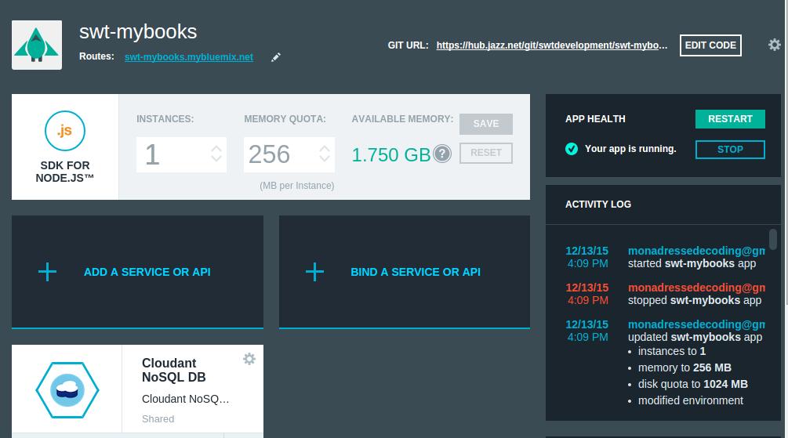
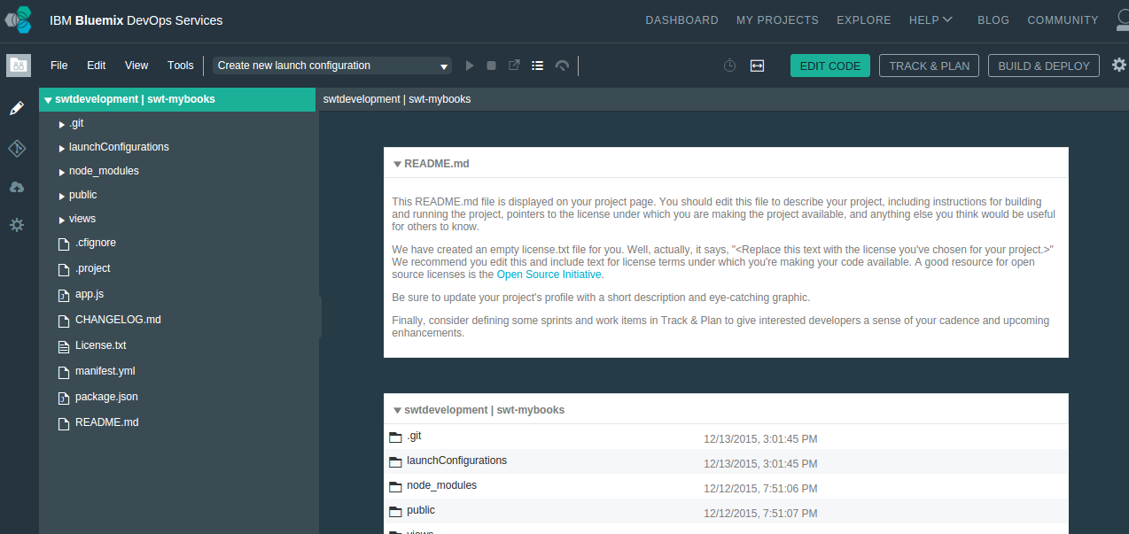
Bluemix Track and Plan Enablement in your application
Step 01: Enable Track and Plan for your app

Slide 4
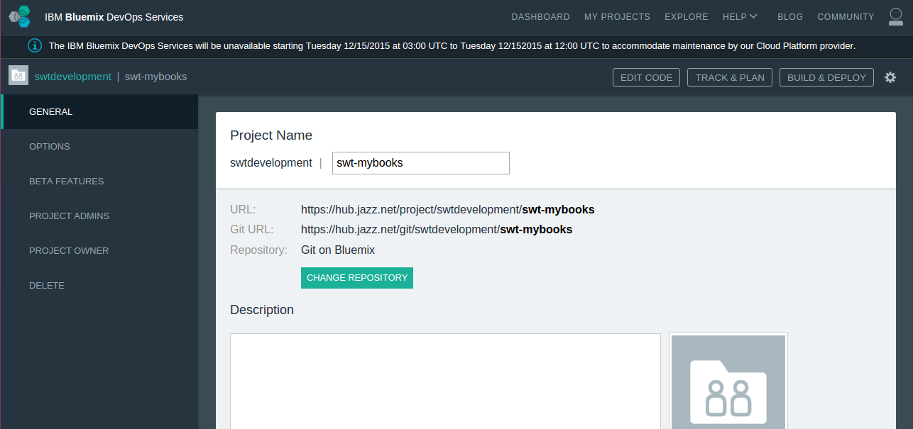
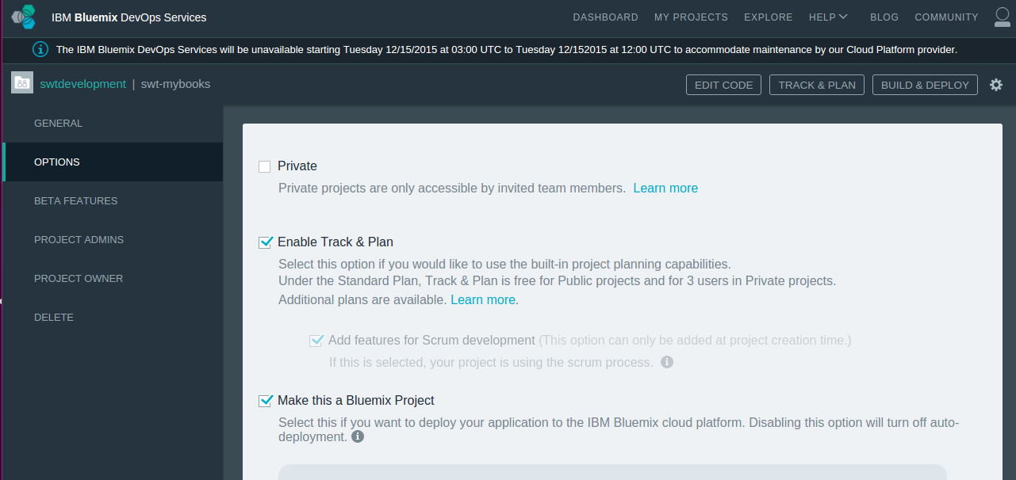

Bluemix Track and Plan Enablement in your application

Slide 5
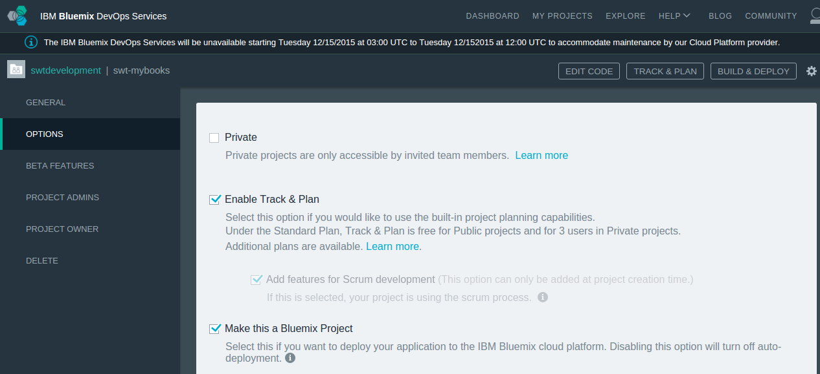
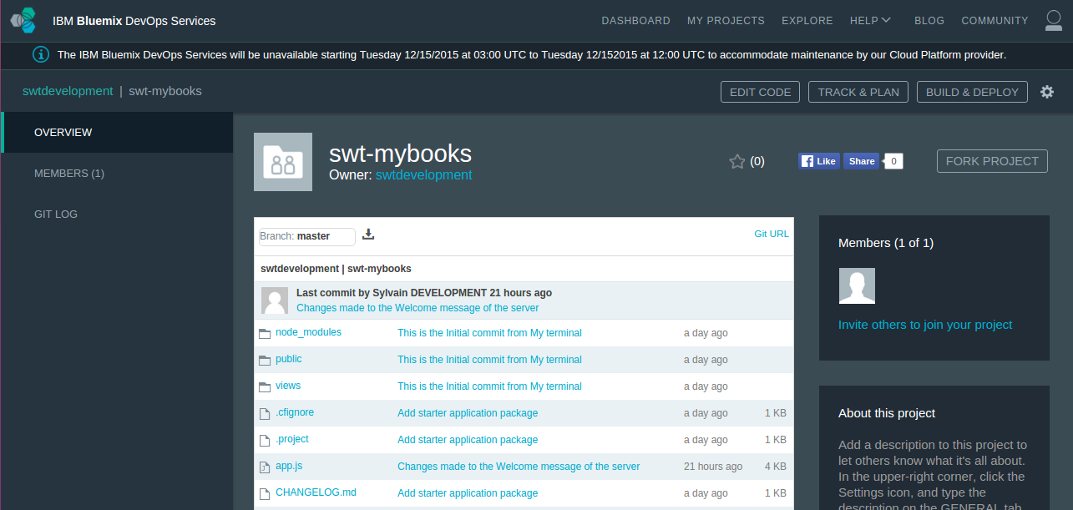
Bluemix Track and Plan Enablement in your application
Step 02: Invite new members

Slide 6
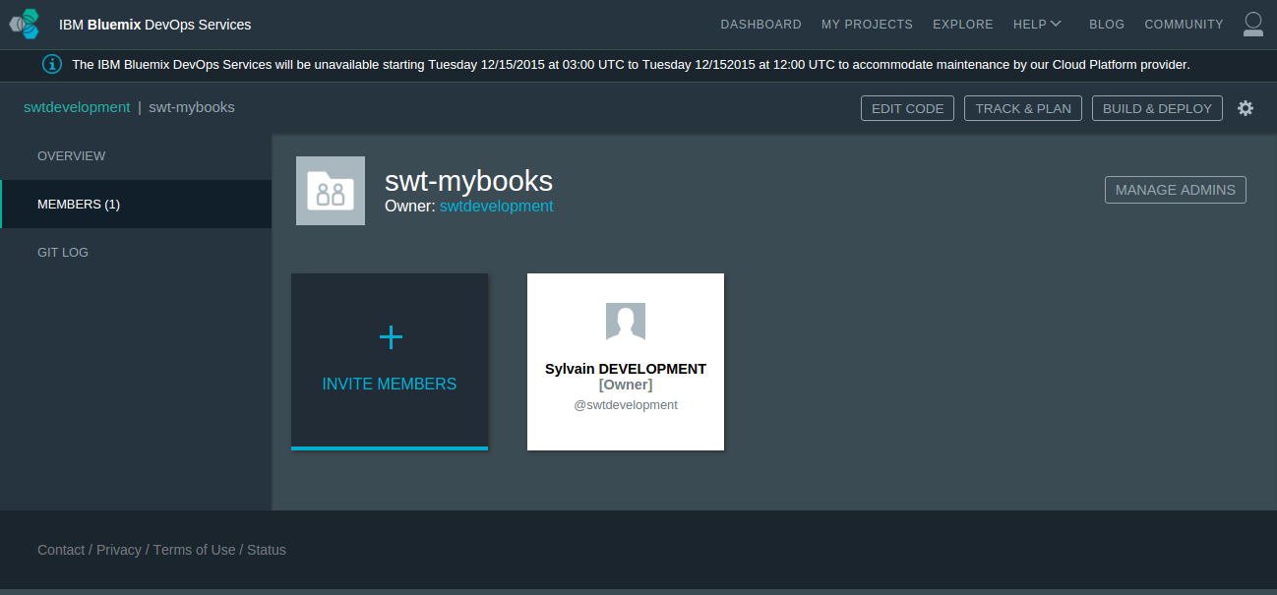
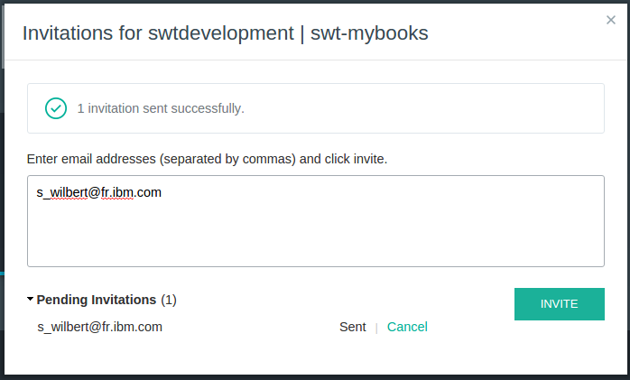
Bluemix Track and Plan Enablement in your application

Slide 7
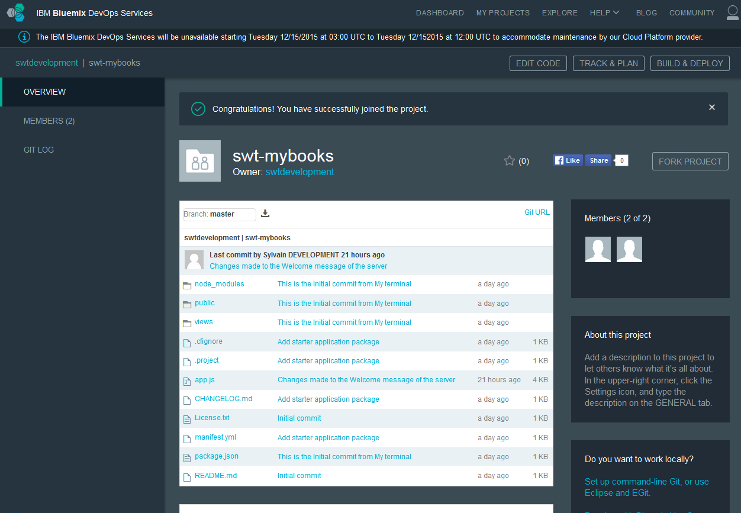
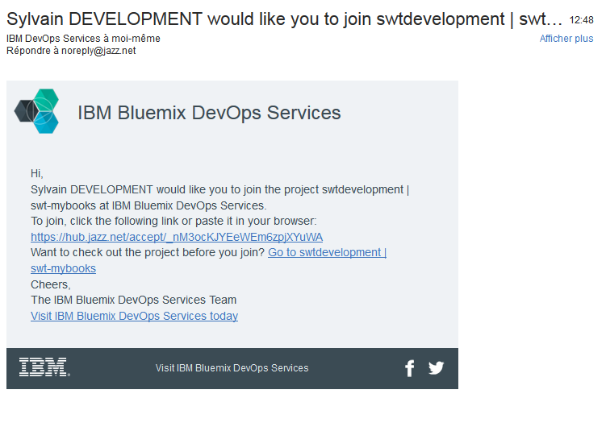
Bluemix Track and Plan The new members have received the invitation and will be able to work

Slide 8
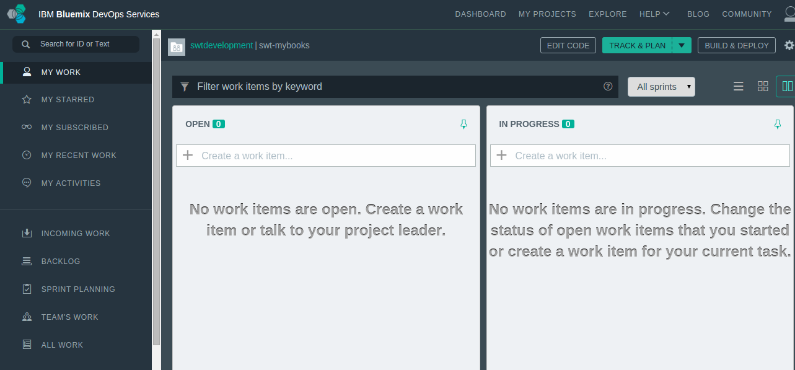
Bluemix Track and Plan Configure Stories and task

Slide 9
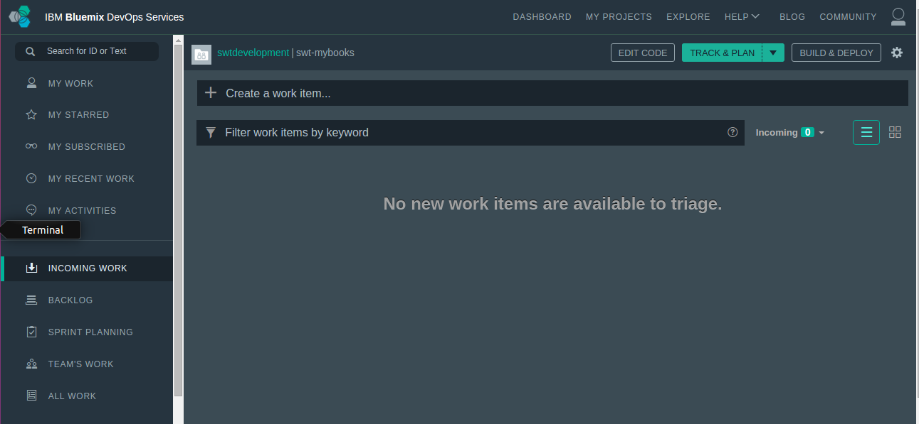
Bluemix Track and Plan Add a new story

Slide 10
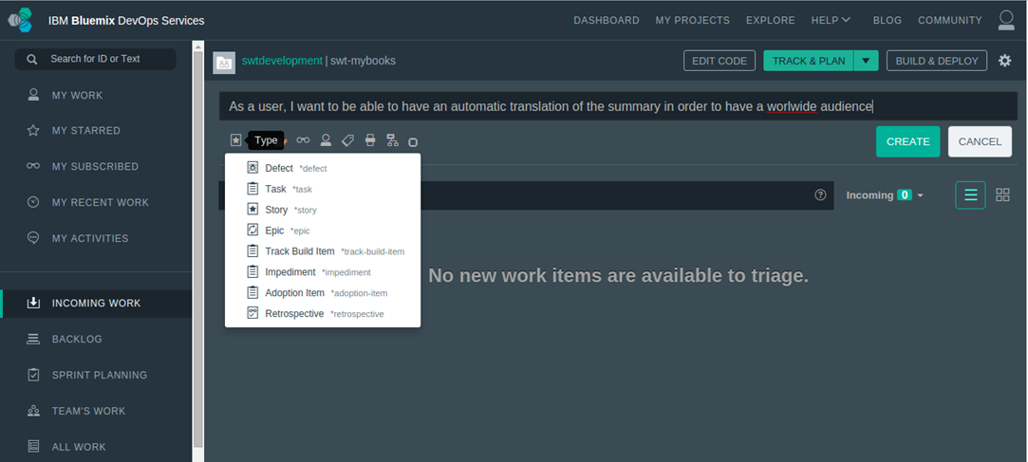
Bluemix Track and Plan Add a new story

Slide 11
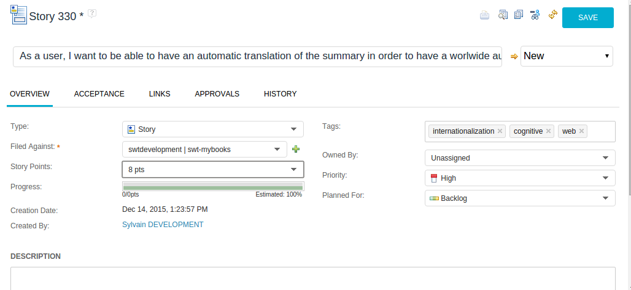
Bluemix Track and Plan Add a new story

Slide 12
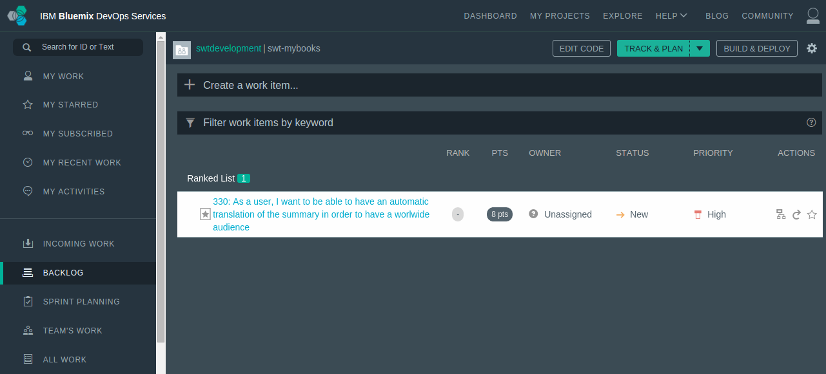
Bluemix Track and Plan Add a new story

Slide 13
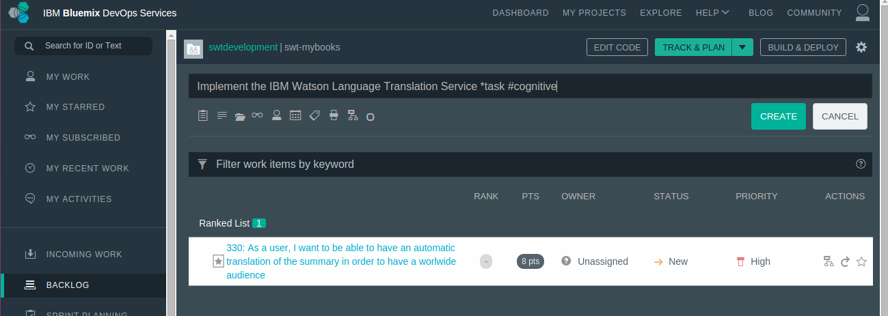
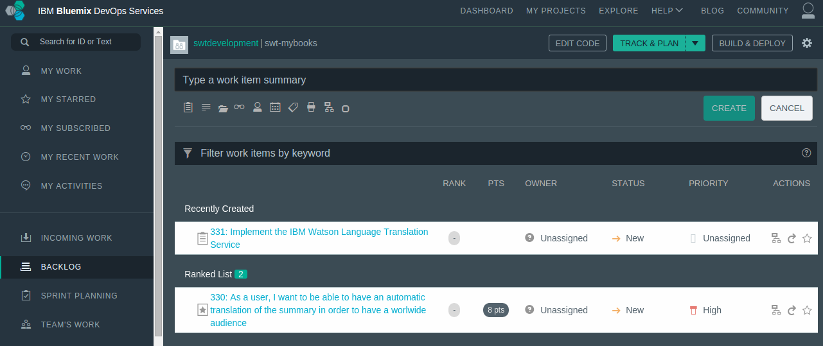
Bluemix Track and Plan Add a new task

Slide 14
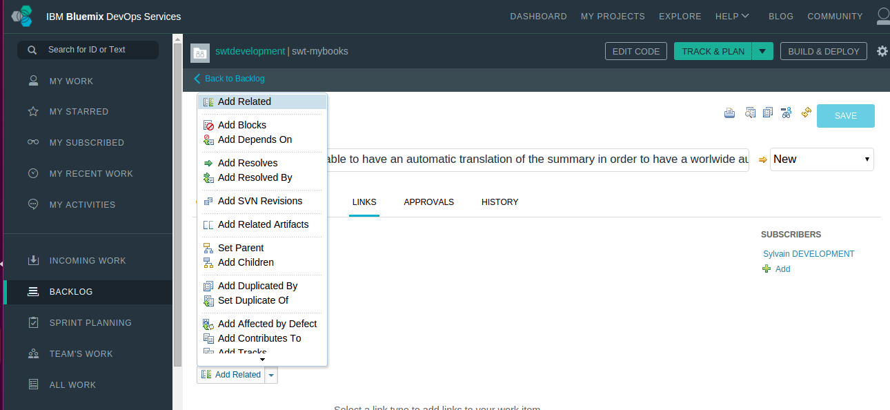
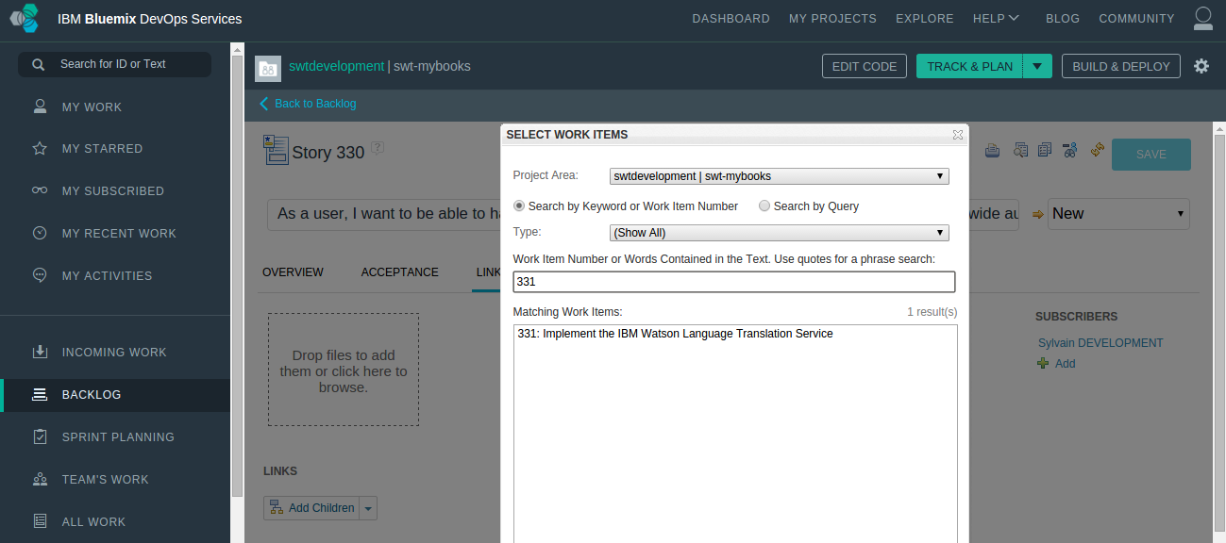
Bluemix Track and Plan Add a new task
From the user story, make a link to the task (Child)

Slide 15
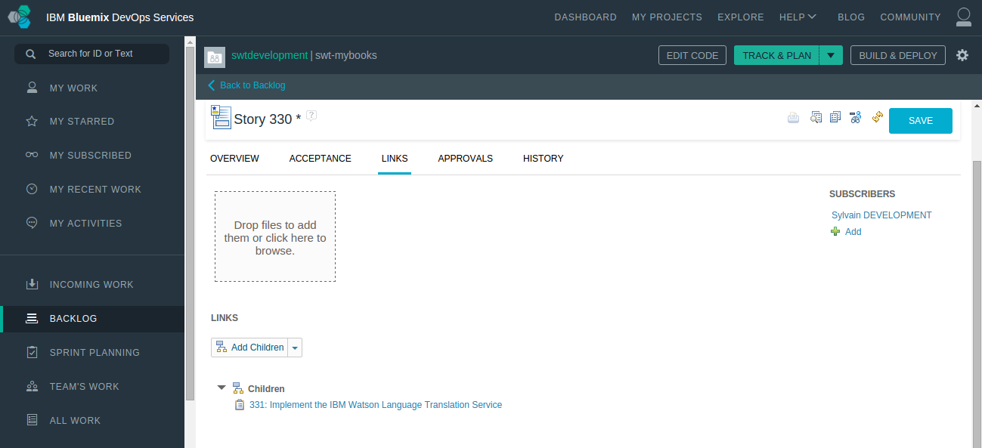
Bluemix Track and Plan Add a new task

Slide 16
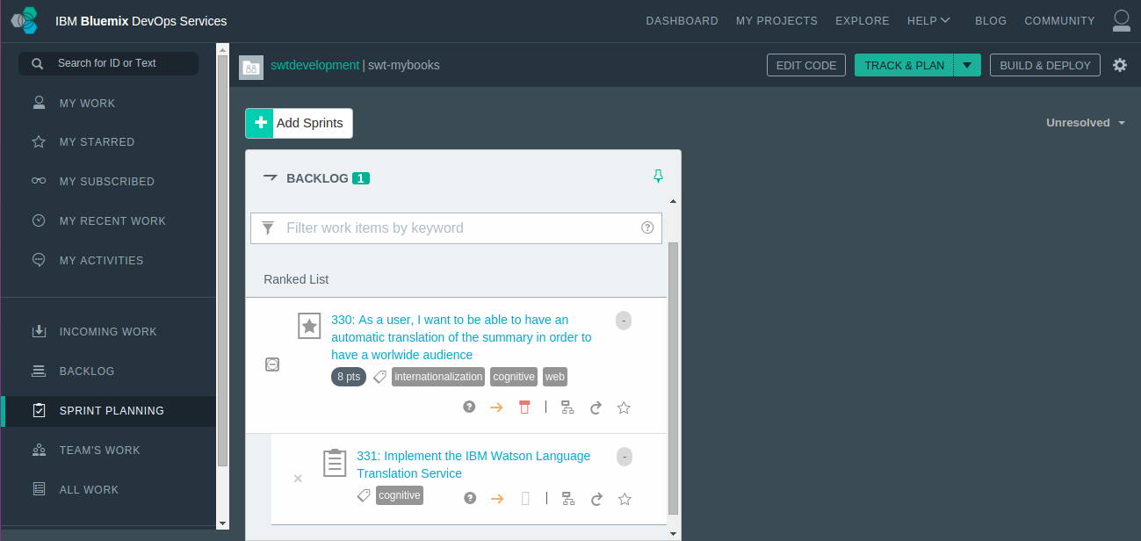
Bluemix Track and Plan Add a sprint

Slide 17
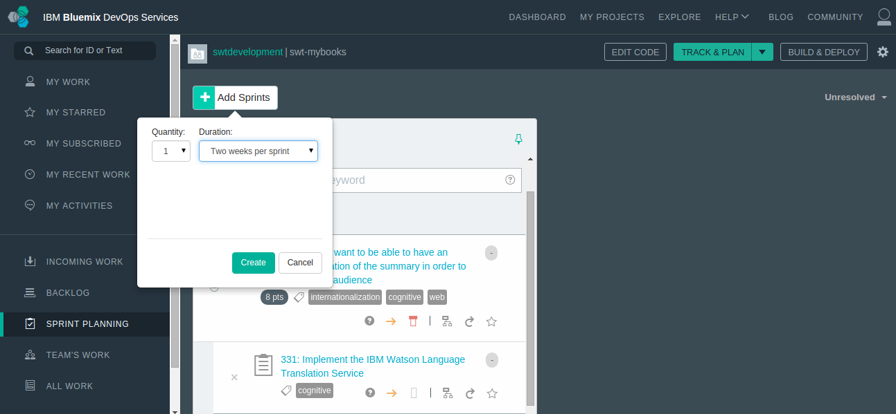
Bluemix Track and Plan Add a sprint

Slide 18
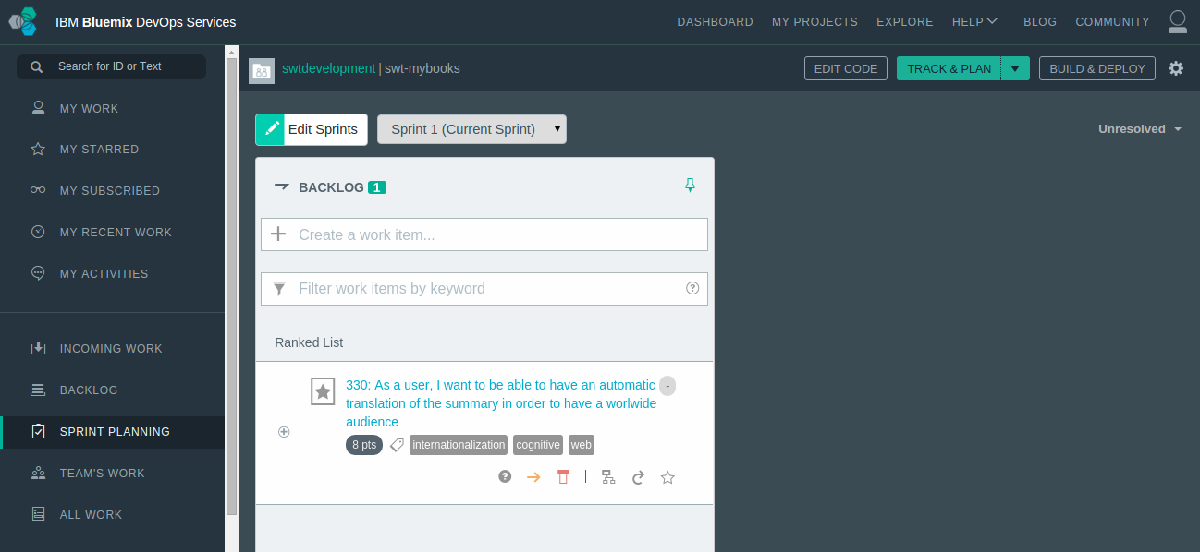
Bluemix Track and Plan Add a sprint

Slide 19
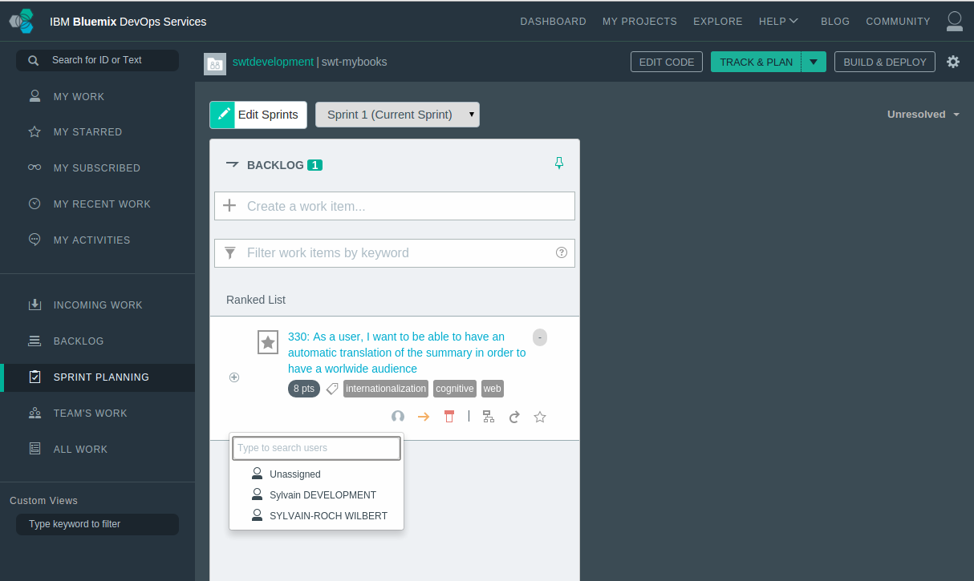
Bluemix Track and Plan Add a sprint

Slide 20
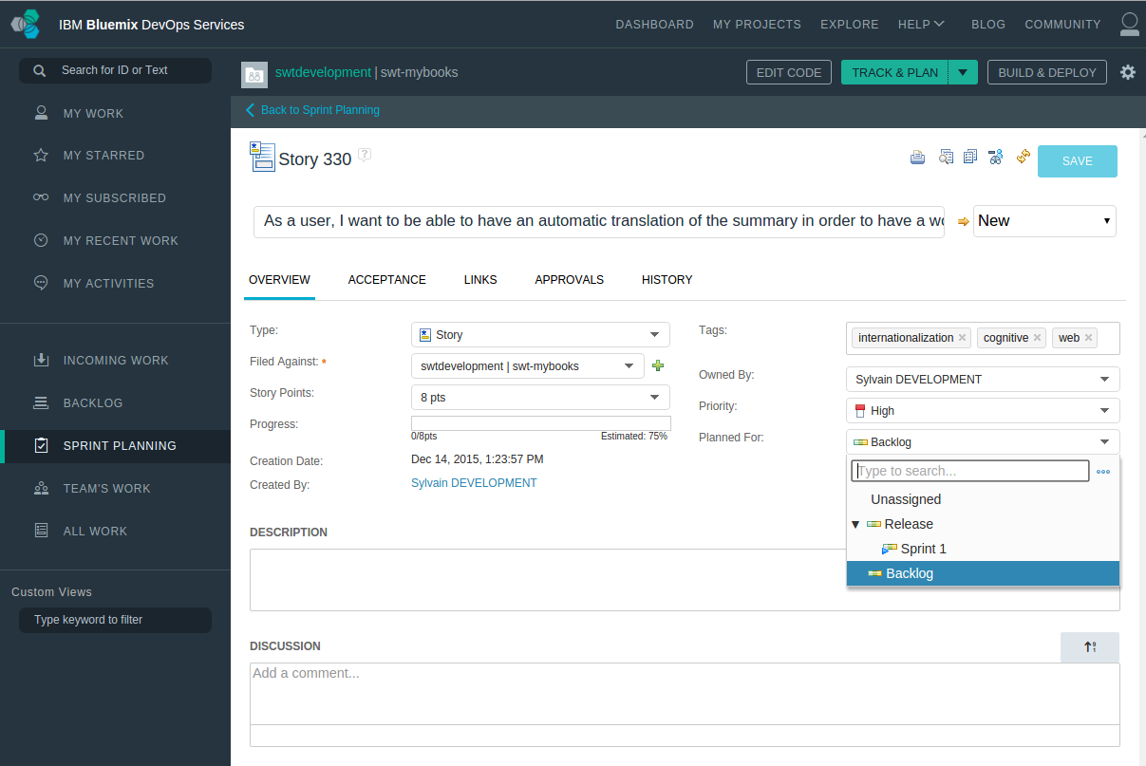
Bluemix Track and Plan Add a sprint
Plan the user story in the Sprint1

Slide 21
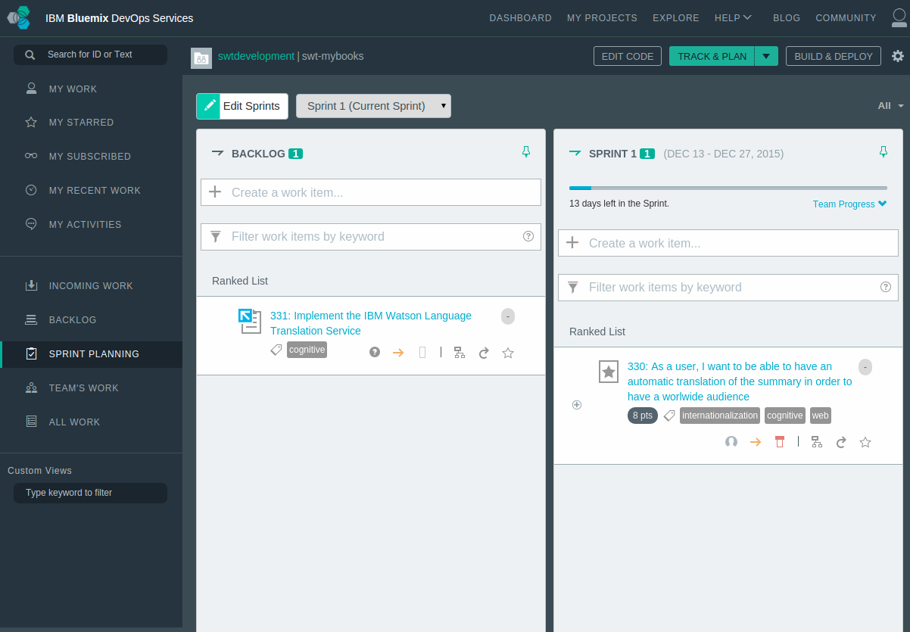

Slide 22
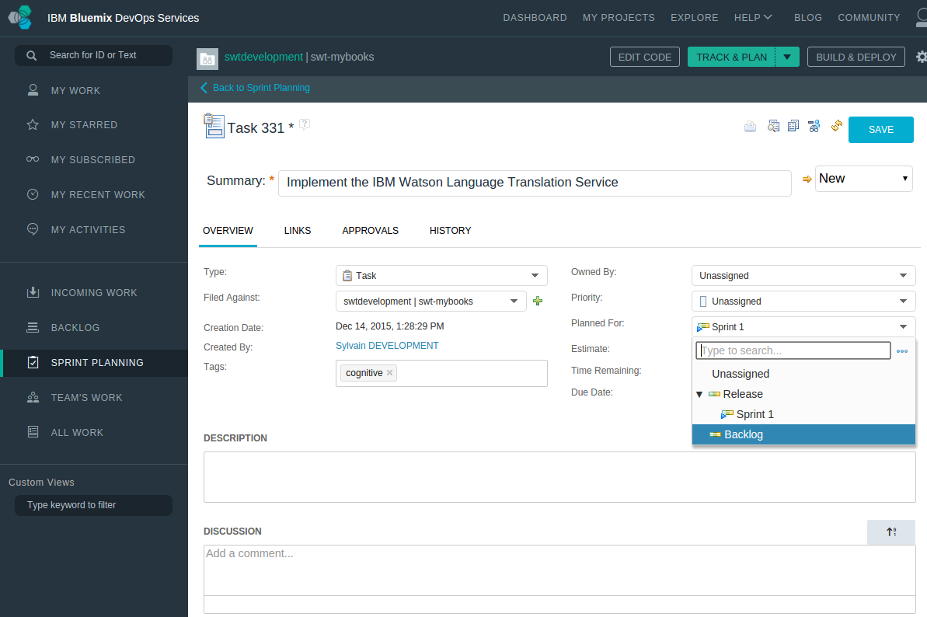
Bluemix Track and Plan Add a sprint
Plan the task in the Sprint1

Slide 23
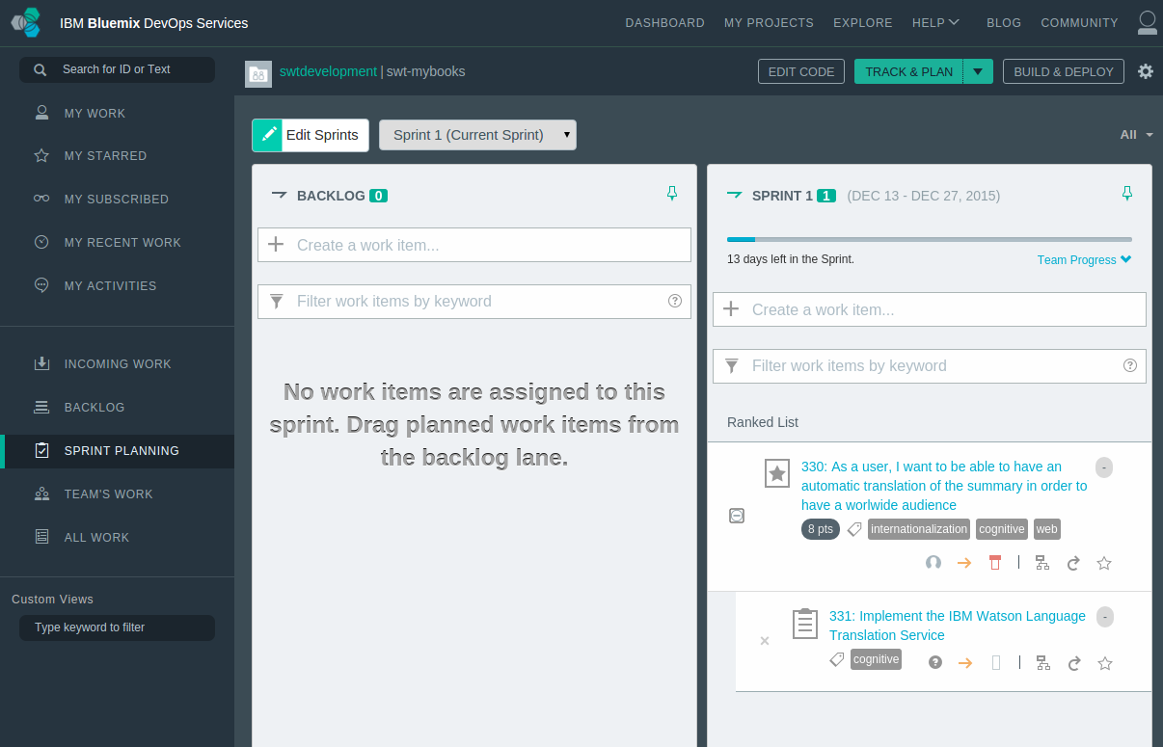
Bluemix Track and Plan Add a sprint

Slide 24
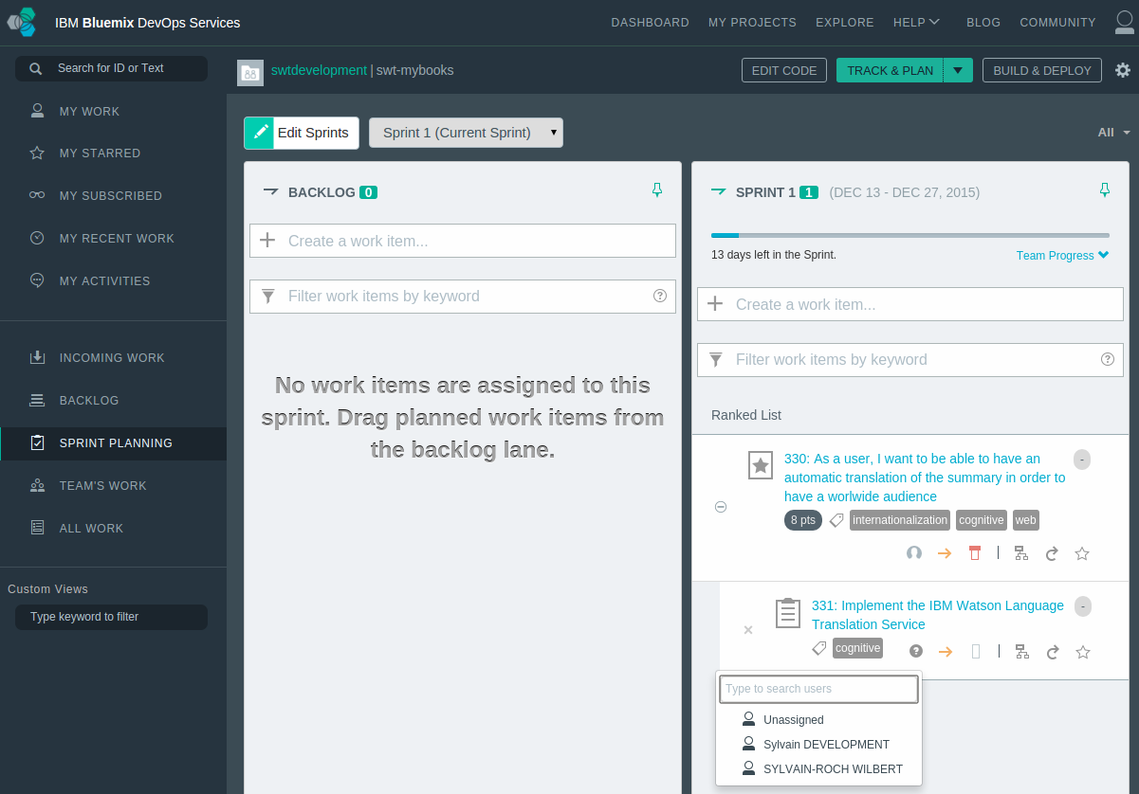
Bluemix Track and Plan Add a sprint

Slide 25
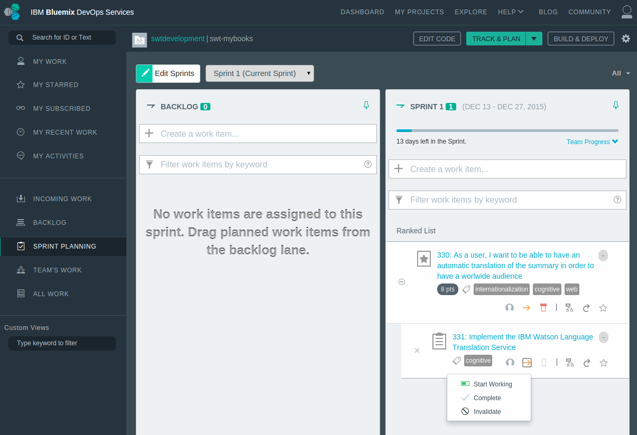
Bluemix Track and Plan Add a sprint

Slide 26
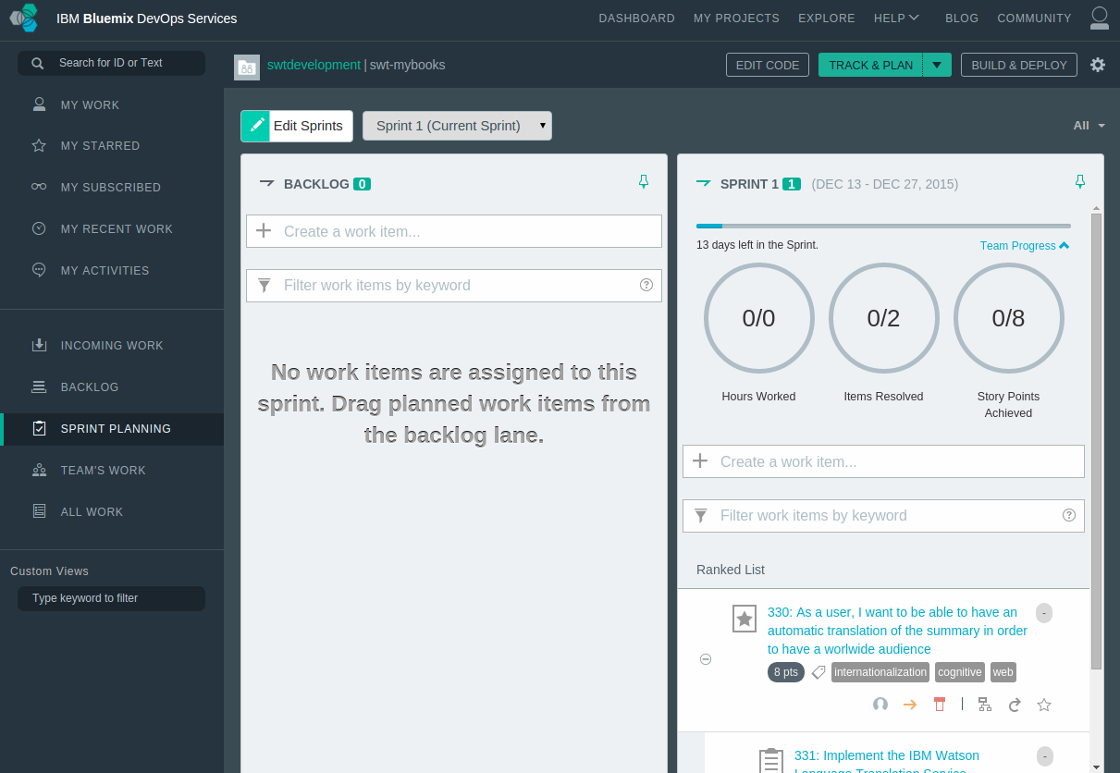
Bluemix Track and Plan Add a sprint

Slide 27
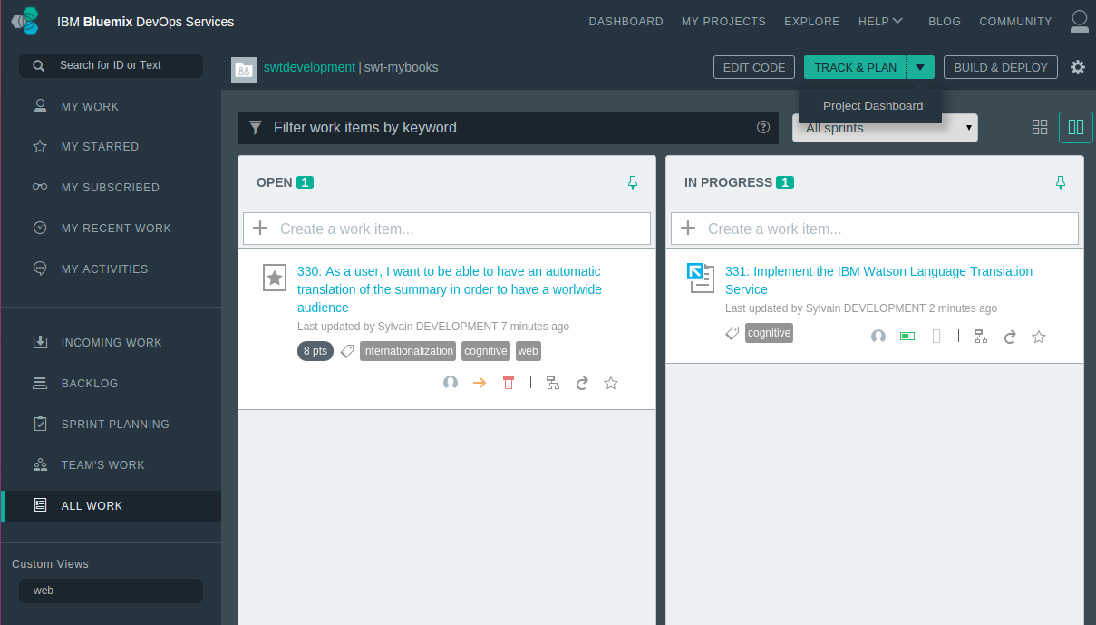
Bluemix Track and Plan Project Dashboard

Slide 28
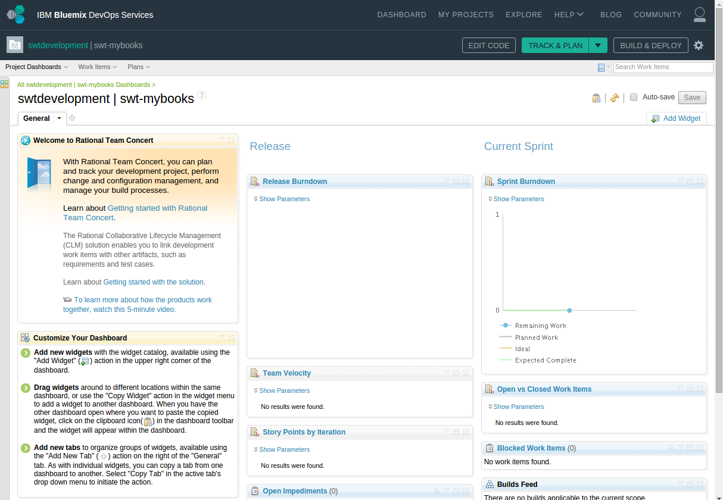
Bluemix Track and Plan Project Dashboard

Slide 29
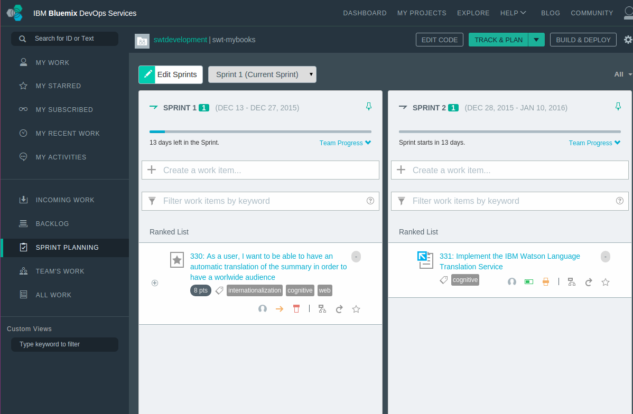
Exercize: Track and Plan
Enable Track and Plan in your Bluemix app
Open your app to new team members
In Track and Plan
Set up a user story (in line with the project) for ex: Adding Automatic Translation
Add it to the backlog
Add a owner, points, tags…
Create tasks for the story ( with owner, tags)
Create 2 sprints and associate the story and tasks in a sprint,
Postopone a task to the the other sprint.
Adjust the completion of the task/story
Display the team progress
Open the Project Dashboard

